Slide 1
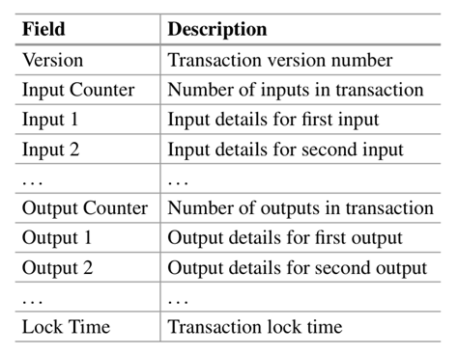
Data Structures for Transaction
A transaction is a data structure that encodes a transfer of value from a source of funds, called an input, to a destination, called an output.
The Version field specifies the rules that this transaction follows.
The Input Counter field indicates the number of inputs included in the transaction, while the Input fields contain one or more transaction inputs.
The Output Counter field denotes the number of outputs included, and the Output fields contain one or more transaction outputs.
The Lock Time field represents a Unix timestamp or block number, which serves as a condition that must be met before the transaction can be added to the blockchain.

Slide 2
Types of Transactions
Different types of transactions in the Bitcoin system have different functions and characteristics.
Standard Transaction:
A standard transaction entails an uncomplicated exchange of value between two parties. It consists of inputs that refer to prior transaction outputs as the source of funds and outputs that assign the transferred value to new recipients.
Multisignature Transaction:
A multisignature transaction necessitates the approval of multiple parties prior to the expenditure of funds. Multiple public keys, often pertaining to distinct individuals or entities, are utilized as inputs for the transaction. Typically, the outputs of the transaction are then locked with a script that specifies the required number of signatures to expend the funds.

Slide 3
Types of Transactions
Segregated Witness (SegWit) Transaction: Segregated Witness is an upgrade to the Bitcoin protocol that isolates the transaction signature data (witness) from the actual transaction data. SegWit transactions have a unique structure and use a unique transaction format, allowing for an increase in transaction capacity and enhanced scalability.
Coinbase Transaction: A Coinbase transaction is a unique type of transaction in Bitcoin that creates new bitcoins and awards them to the miner who successfully adds a new block to the blockchain. It is the first transaction in every block and serves as the mechanism for issuing new bitcoins into circulation, as well as rewarding miners for their work in securing the network.
Lock Time–Enabled Transaction: Lock time enables the sender of a transaction to specify a future time or block height at which the transaction will become valid. Lock time–enabled transactions are useful for a variety of use cases, including the creation of time-locked transactions, the implementation of conditional spending, and the creation of payment channels similar to the Lightning Network.

Slide 4
Types of Transactions
Segregated Witness (SegWit) Transaction
Segregated Witness (SegWit) is an upgrade to the Bitcoin protocol introduced in 2017 (BIP141).
It solves two major problems in Bitcoin:
Transaction malleability (a bug that allowed modification of transaction IDs)
Limited block capacity (only about 1 MB of data per block)
A Bitcoin transaction has two main parts:
Transaction Data – who sends how many bitcoins to whom
Signature (Witness) Data – cryptographic proof that the sender owns those bitcoins
Before SegWit, both of these were stored together inside the block.
SegWit separates (segregates) the witness (signature) from the main transaction data.
This means the signature data is moved to a separate structure, not counted fully toward the 1 MB block limit.

Slide 5
Types of Transactions
Example: Before vs After SegWit
Before SegWit (Legacy Transaction)
Transaction ID
Inputs (with signatures) | <-- Signatures included here
Outputs (who receives bitcoins)
All data including signatures is inside the same structure.
So, if a transaction had large signatures, it made the block big quickly.
After SegWit
Transaction ID
Inputs (without signatures) | <-- Smaller now
Outputs
↓
Separate “Witness Data”
(Signatures stored here)
Now the witness (signature) part is stored separately, reducing the “main” transaction size and allowing more transactions per block.

Slide 6
Types of Transactions
Illustrative Example
Let’s say:
Alice sends 1 BTC to Bob.
The transaction has 250 bytes of data.
Out of that, 100 bytes are signatures.
➤ Before SegWit:
The entire 250 bytes count toward the block size limit (1 MB).
➤ After SegWit:
Only 150 bytes (non-witness data) count fully toward the 1 MB limit.
The 100 bytes of witness data count at a reduced weight (1/4 of normal).
Effective total = 150 + (100 / 4) = 175 bytes.
This means more transactions fit into one block.

Slide 7
Types of Transactions
Benefits of SegWit
Increased capacity: Because witness data is discounted, more transactions fit in a block.
Lower fees: Smaller effective size = less fee per transaction.
Fixes malleability: Transaction IDs no longer change if the signature changes.
Enables Layer 2 solutions: Technologies like the Lightning Network depend on SegWit.
Legacy address VS. SegWit address
A legacy address starts with 1
A SegWit address starts with 3 (P2SH) or bc1 (bech32).
Example:
Legacy Address: 1A1zP1eP5QGefi2DMPTfTL5SLmv7DivfNa
SegWit Address: bc1qar0srrr7xfkvy5l643lydnw9re59gtzzwf5mdq

Slide 8
Types of Transactions
A real life Analogy:
Think of a Bitcoin block as a suitcase.
Before SegWit, you packed everything (money + documents) inside it, and it filled up quickly.
After SegWit, you moved the documents (signatures) to a side pouch, freeing up more room for actual items (transactions).
More fits in one suitcase = more transactions per block!

Slide 9
Types of Transactions
What is Locktime?
Locktime (nLockTime) is a field in every Bitcoin transaction that specifies when the transaction becomes valid — meaning it can’t be included in a block until a specific time or block height has passed.
So, Locktime = “Do not spend this transaction before ___.”
How It Works Internally
By block height
If nLockTime < 500,000,000, it represents a block height.
Example: nLockTime = 800000 → valid only after block #800,000 is mined.
By Unix timestamp
If nLockTime >= 500,000,000, it represents a Unix time (seconds since 1 Jan 1970).
Example: nLockTime = 1759872000 → valid only after October 8, 2025, 00:00:00 UTC.

Slide 10
Types of Transactions
Example: Time-Locked Savings Account
Alice wants to send 1 BTC to her son, but she wants him to receive it on his 18th birthday, not before.
She creates a transaction like this:
Field | Value
Input | Alice’s UTXO
Output | 1 BTC → Son’s address
nLockTime | October 8, 2030 (Unix time = 1917638400)
Meaning:
Even if someone broadcasts this transaction today, it will not be mined into a block until after October 8, 2030.

Slide 11
Types of Transactions
What is Block Height?
Block height refers to the position or number of a block in the blockchain. It represents how many blocks have been added to the blockchain since the genesis block (the first block).
For example:
The genesis block (first block) has a block height of 0.
The next block has a height of 1, and so on.
For example, if a transaction has a lock time of block height 800,000, it means:
The transaction cannot be included in the blockchain until block 800,000 is mined.
If the current block height is 799,500, the transaction remains invalid until 500 more blocks are added.

Slide 12
Types of Transactions
Why is Lock Time is useful?
Lock time enables time-locked transactions, allowing:
Delayed payments (e.g., escrow releases at a future date).
Conditional spending (funds become available only after a certain block height).

Slide 13
Transaction Input and Output
Unspent transaction outputs (UTXOs) are the foundational building block of a bitcoin transaction.
UTXOs are immutable units of bitcoin currency that are locked to a specific proprietor, recorded on the blockchain, and recognized by the entire network as currency units.
The bitcoin network keeps track of the millions of available (unspent) UTXOs. Every time a user receives bitcoin, the quantity is recorded as a UTXO in the blockchain.
A user’s bitcoins could be dispersed as UTXO across hundreds of transactions and hundreds of blocks.
In practice, there is no such thing as a Bitcoin address or account balance; only scattered UTXOs are locked to specific proprietors.
The wallet application generates the notion of a user’s Bitcoin balance. The wallet computes the user’s balance by searching the blockchain and summing all of the user’s UTXOs.

Slide 14
Transaction Input and Output
Once created, UTXOs must be consumed in their entirely and generate change. For example, a transaction with a 20-Bitcoin UTXO would consume the entire 20 Bitcoin UTXO and produce two outputs: paying 1 Bitcoin to the recipient and returning 19 Bitcoins in change back to the wallet.
Most bitcoin transactions generate change. A user’s wallet application automatically selects various units from their available UTXOs to compose an amount greater than or equal to the desired transaction amount.
The wallet application can use strategies like combining smaller units, finding exact change, or using a single unit larger than the transaction value and making change.
Transaction inputs are the UTXOs consumed by a transaction, while outputs are the UTXOs created by a transaction.

Slide 15
Mining Bitcoin
Mining is the process of adding new transactions to a blockchain and securing the network through the resolution of complex mathematical riddles.
Network participants, known as miners, compete to solve a cryptographic algorithm known as proof of work (PoW).
Miners collect valid transactions into blocks and then apply a mathematical function (hashing) to the block’s data, which includes a reference to the previous block.
The newly mined block is broadcast to the network by the first miner to discover a valid hash satisfying the criteria. Other miners then verify the block’s transactions for validity.
If consensus is achieved that the block is valid, it is added to the blockchain and the miner is compensated with newly minted Bitcoins and transaction fees from the included transactions.

Slide 16
Mining Bitcoin
Bitcoin mining serves the two following primary purposes:
Transaction validation: Miners ensure the integrity and accuracy of the Bitcoin ledger by validating and including valid transactions in new blocks.
Blockchain security: As a security mechanism, the computational effort required for mining (PoW) serves as a security measure.
Nakamoto consensus is the consensus mechanism utilized by Bitcoin. Nakamoto consensus is attained through the consensus of the majority of miners. Miners determine collectively which chain is deemed “longest” and, therefore, legitimate. This is determined by the chain with the most accumulated PoW, indicating the greatest investment of computational effort in its creation.

Slide 17
Cost of Mining Bitcoin
Bitcoin mining incurs substantial costs due to the required resources and associated expenses. What follows is a summary of the costs associated with Bitcoin mining.
Hardware Costs: Bitcoin mining necessitates mining rigs or Application-Specific Integrated Circuits (ASICs). These machines are designed specifically to execute the computational tasks required for mining.
Electricity Costs: The mining industry consumes a considerable quantity of electricity. Mining necessitates a significant amount of computational capacity, resulting in substantial electricity costs. Miners must consider the local electricity rates and calculate the energy consumption of their mining apparatus in order to estimate their ongoing costs.
Cooling and Maintenance Costs: The intense computational activities of mining equipment generate heat. Effective cooling systems are required to prevent combustion and prolong the life of mining machinery. These cooling solutions, such as fans and specialized cooling systems, require additional expenditures.

Slide 18
Cost of Mining Bitcoin
Operating Costs: In addition to hardware and electricity costs, mining incurs additional operating expenses. Expenses associated with Internet connectivity, facility rental (if mining operations are conducted in a dedicated space), mining software licenses, and other miscellaneous expenses may be included.
Competition and Return on Investment: The level of competition influences the expense of Bitcoin mining. As more miners join the network, the mining difficulty rises, necessitating more computational power and, as a result, increased electricity consumption. Individual miners’ return on investment (ROI) is diminished as a result of escalating competition.
Market Volatility: Bitcoin’s price volatility is an additional factor that impacts mining costs. The fluctuating price of Bitcoin has a direct impact on the profitability of Bitcoin mining. A higher Bitcoin price can make mining more profitable, whereas a significant decline in price can make mining less lucrative or even unprofitable for some miners.

Slide 19
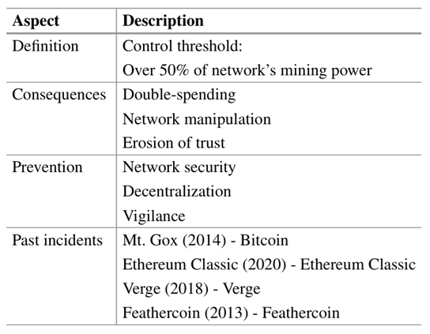
51% Attack in Bitcoin Mining
A 51% attack occurs when a single entity or group of cooperating entities controls more than fifty percent of the network’s total mining capacity.
This majority control enables the attacker to potentially control the blockchain and dictate the norms of consensus.
The adjacent table delineates the definition of a 51% attack within the realm of cryptocurrency. The provided explanation elucidates that a 51% attack transpires when an entity acquires dominion over more than 50% of the mining power within a network.

Slide 20
How to Mitigate 51% Attack
Although a 51% attack is theoretically possible, several factors mitigate the risks:
Incentives for honesty: There are economic incentives for honest behavior and adherence to consensus norms among miners. Any attempt to manipulate the network could erode trust, decrease Bitcoin’s value, and harm the attacker’s own investments.
Decentralization: The decentralized nature of cryptocurrency mining guarantees that no single entity will be able to control the entire network. This decentralization makes acquiring majority control of mining power difficult and expensive.
Community vigilance: The Bitcoin community monitors the network for suspicious activity. Rapid detection and disclosure of potential attacks detect criminals.
Network upgrades: Periodic Bitcoin protocol updates and enhancements resolve known vulnerabilities and strengthen the network’s resistance to attack.

